Slide 1


Consumer Goods Ad_Hoc Insights
Linkedin
Hardware
Enhancing Data-Driven Decision Making
Presented By Umang Badola

Slide 2
AGENDA
Details about Company Background
Market Position
Data Sets
Key Insights

Slide 3
Company Background
Overview :
Atliq Hardwares is a leading computer hardware producer, specializes in high-performance products such as motherboards, graphic cards, processors, and storage devices.
Problem Statement:
Management struggles with making quick, data-driven decisions due to insufficient insights.
Approach:
Conducted SQL analysis to address 10 key requests, providing actionable insights on customer operations, product performance, and sales channels to enhance strategic decision-making.

Slide 4
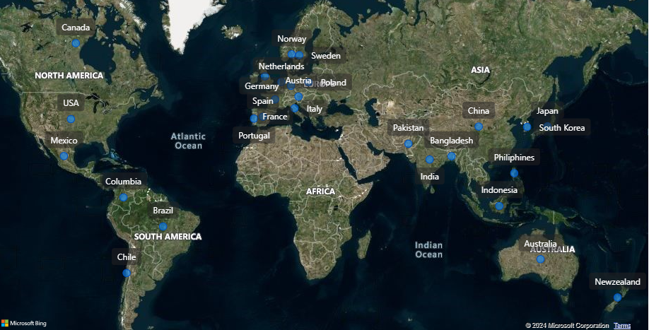
Atliq’s Market Position
Dominant in India with a strong APAC presence
Atliq Hardwares is expanding into global markets, leveraging innovation and quality to outpace competitors.

Slide 5
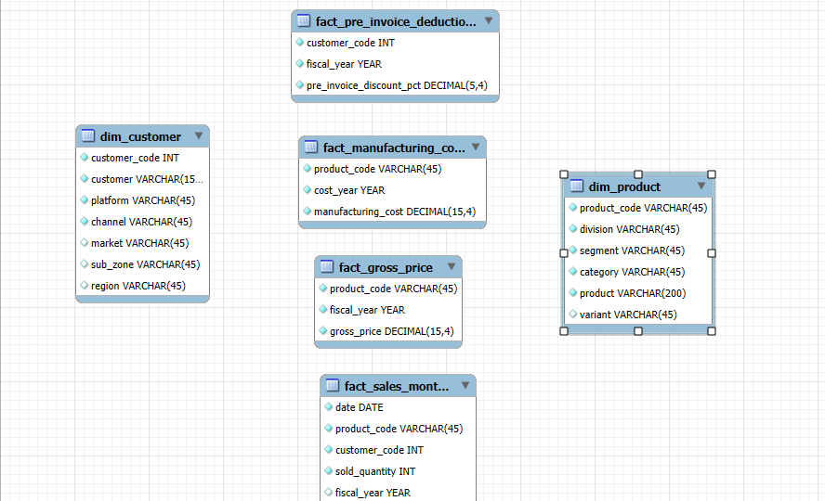
Data Sets

Slide 6
Atliq’s Product Lines
PC
P&A
N&S
Desktop
Notebook
Peripherals
Accessories
Networking
Storage
Business
Laptop
Gaming
Laptop
Graphic
Card
Batteries
WI FI
Extender
External
SSD
Personal
Laptop
Business Laptop
Motherboard
Mouse
USB Flash
drives
Processors
Personal
Laptop

Slide 7
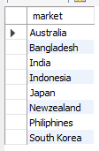
Request 1
Provide the list of markets in which customer "Atliq Exclusive" operates its business in the APAC region.

Slide 8
Insights

Slide 9

Request 2
What is the percentage of unique product increase in 2021 vs. 2020? The final output contains these fields:
unique_products_2020 unique_products_2021 percentage_chg

Slide 10
Insights
36%
There is a increase of 36%
Between 2020 and 2021 Products
Products in 2020 = 245
Products in 2021 = 334

Slide 11
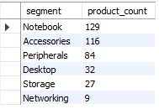
Request 3
Provide a report with all the unique product counts for each segment and sort them in descending order of product counts. The final output contains 2 fields:
Segment
product_count

Slide 12
Insights
We offer a diverse product lineup, including 129 products in the Notebook segment, 116 in Accessories, and 84 in Peripherals.
However, there is an opportunity to expand our portfolio in the Desktop (32 products), Storage (27 products), and Networking (9 products) segments to achieve better market coverage.

Slide 13
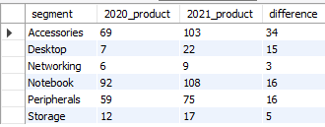
Request 4
Which segment had the most increase in unique products in 2021 vs 2020? The final output contains these fields: segment
product_count_2020 product_count_2021 difference

Slide 14
Insights
We offer a diverse product lineup, including 129 products in the Notebook segment, 116 in Accessories, and 84 in Peripherals.
However, there is an opportunity to expand our portfolio in the Desktop (32 products), Storage (27 products), and Networking (9 products) segments to achieve better market coverage.

Slide 15

Request 5
Get the products that have the highest and lowest manufacturing costs. The final output should contain these fields:
product_code
product manufacturing_cost

Slide 16


Product with Highest and Lowest Manufacturing Cost
Highest
Low
240.54
0.89
A6120110206
AQ HOME Allin1 Gen 2
Personal Desktop
A2118150101
AQ Master wired x1 Ms
Mouse

Slide 17
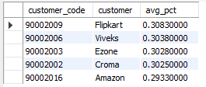
Request 6
Generate a report which contains the top 5 customers who received an average high pre_invoice discount_pct for the fiscal year 2021 and in the Indian market. The final output contains these fields:
customer_code
customer average_discount_percentage

Slide 18
Insights
In 2021, we provided similar pre-invoice discount percentages to our top 5 customers, with Flipkart receiving the highest discount in the Indian market at 30.83%.
Flipkart Viveks Ezone Croma Amazon

Slide 19
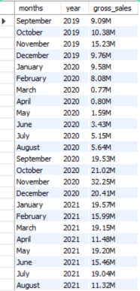
Request 7
Get the complete report of the Gross sales amount for the customer “Atliq Exclusive” for each month. This analysis helps to get an idea of low and highperforming months and take strategic decisions. The final report contains these columns:
Month
Year
Gross sales Amount

Slide 20
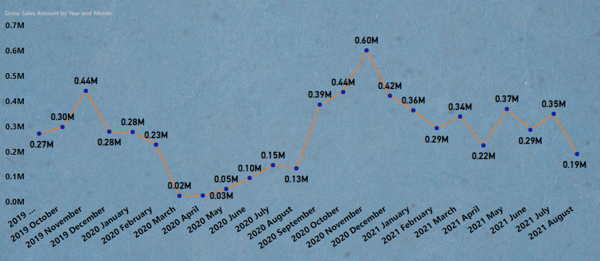
Gross Sales Monthly Report (Atliq Exclusive)
Pandemic 2nd Wave
Pandemic 1st Wave

Slide 21

Request 8
In which quarter of 2020, got the maximum total_sold_quantity? The final output contains these fields sorted by the total_sold_quantity:
Quarter
total_sold_quantity

Slide 22
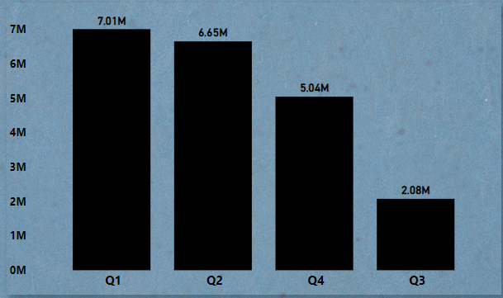
Total Sold Quantity
Total sold quantity for Q1
This difference is caused due to the pandemic during March, April, May 2020
Q3 has Lowest sold Quantity

Slide 23

Request 9
In which quarter of 2020, got the maximum total_sold_quantity? The final output contains these fields sorted by the total_sold_quantity:
Quarter
total_sold_quantity

Slide 24
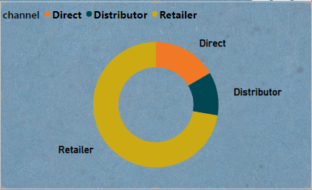
Gross Sales and Sales Contribution Percentage By Channel (2021)
Direct Contributed around 15.47%
15.47%
Retailer Contributed around 73.22%
11.31%
73.22%
Distributor Contributed around 11.31%

Slide 25

Request 10
Get the Top 3 products in each division that have a high total_sold_quantity in the fiscal_year 2021? The final output contains these fields:
division
product_code
Product
total_sold_quantity rank_order

Slide 26



Top 3 Highest Selling Product (Division)
PC
N&S
P&A

